Slide 1
Insights to prices & demographics of resale flats in Singapore
By: Zheng Yimin
NSDAI/01
p7053148

Slide 2
Datasets used
1. resale-flat-prices-based-on-registration-date-from-jan-2017-onwards.csv
Link: https://data.gov.sg/dataset/resale-flat-prices
2. age-of-hdb-resident-population-by-geographical-distribution.csv
Link: https://data.gov.sg/dataset/sample-household-survey-hdb-resident-population-by-geographical-distribution
3. gender-composition-of-hdb-resident-population-by-ethnic-group.csv
Link: https://data.gov.sg/dataset/gender-composition-of-hdb-resident-population-by-ethnic-group-and-flat-type
4. labour-force-participation-rate-of-hdb-resident-population-by-flat-type.csv
Link: https://data.gov.sg/dataset/labour-force-participation-rate-for-hdb-population-by-ethnic-group-and-flat-type

Slide 3
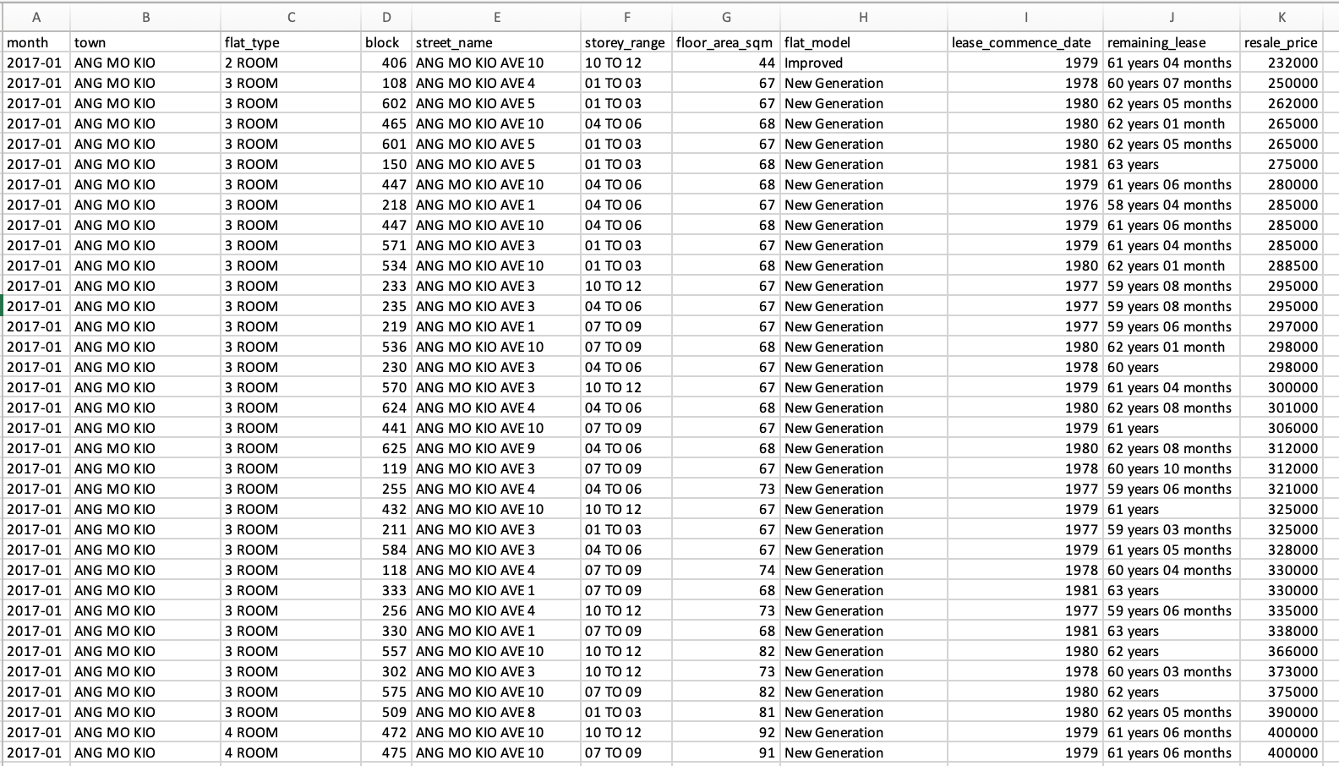
1. resale-flat-prices-based-on-registration-date-from-jan-2017-onwards.csv
Includes details such as month, town, flat type, block, street name, storey range, floor area (in sqm), flat mode, lease commence date, remaining lease, resale price

Slide 4
Objectives
To find out the latest resale prices (in the last 12 months – i.e. 2021-01 onwards) of different towns / flat types
To compare and gauge which town is a more affordable option to live in, for a specific flat type (e.g. 4 room flat)
Peculiarities – When trying to derive the mean/median values, ‘NaN’ values sometimes show up in the dataset, which causes errors when trying to plot the charts.

Slide 5
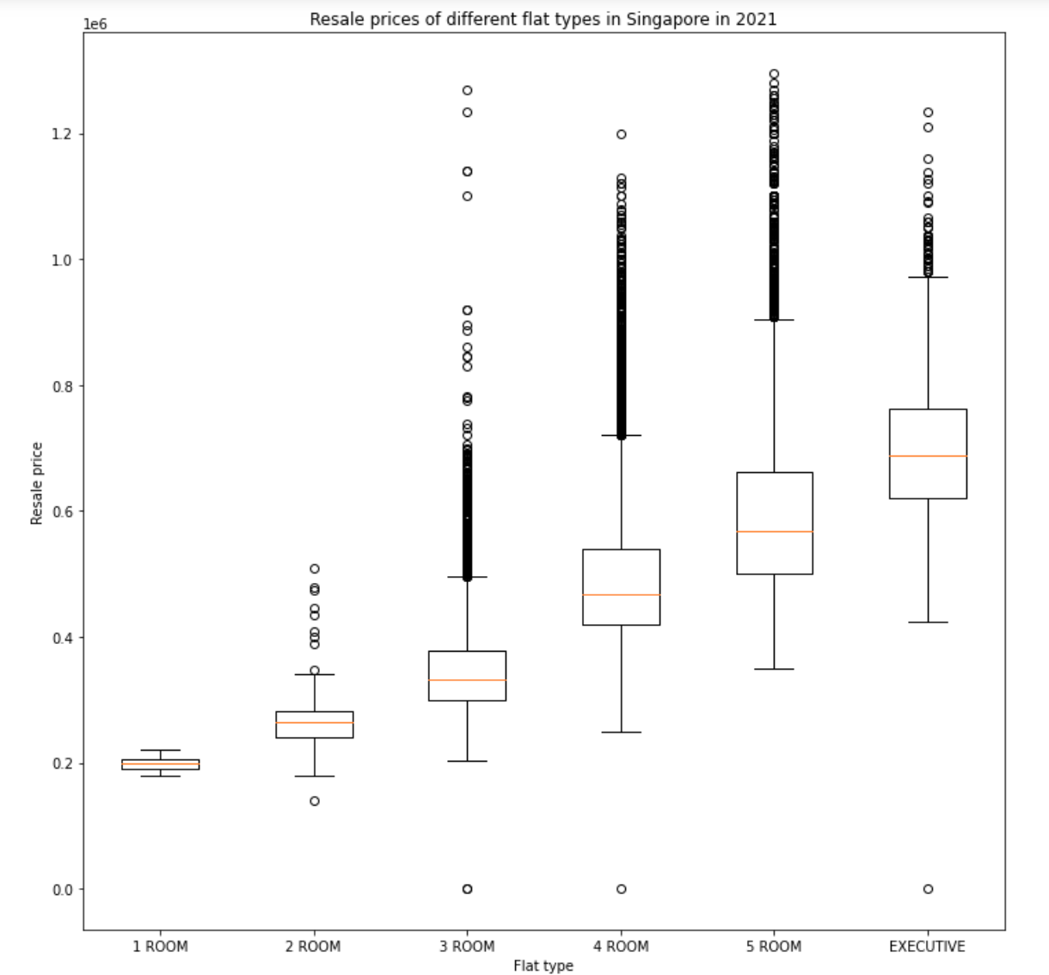
Graph 1.1 – Boxplot of resale prices of various flat types in 2021 - Process
Data was filtered to show only 2021 values of each flat type
Numpy arrays of resale prices are created respectively based on different flat types
Boxplots are then created using matplotlib function – plt.boxplot, where the x-axis shows the flat types, and y-axis shows the resale prices in 2021.

Slide 6
Graph 1.1 – Boxplot of resale prices of various flat types in 2021 - Insights
As there are many outliers especially for 3 Room, 4 Room, 5 Room and executive flats, the median price of the resale flats would be a better gauge of the general resale prices of various flat types in 2021.
Overall, 5 room flat prices seems to have the highest variability, as seen from the length of its box plot.
The outlier may be caused by extreme house prices especially in the more popular districts.

Slide 7
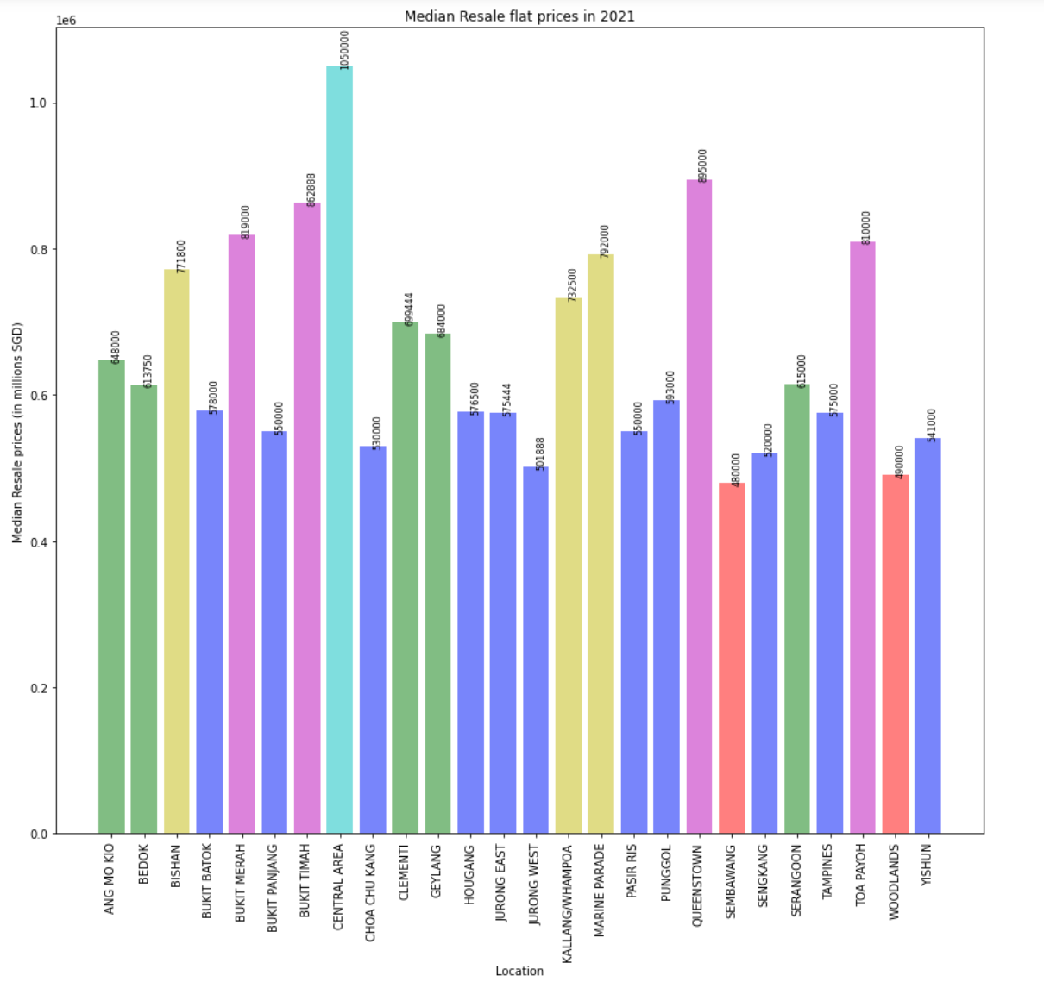
Graph 1.2 – Bar chart of resale prices of various locations for 5 room flats in 2021 - Process
Data was filtered to show only 2021 values of each location.
Data was also filtered to only include 5 room flat values
Np.median was used to derive the median prices of resale flats per location in 2021
Bar charts are then created using matplotlib function – plt.bar, where the x-axis shows the location, and y-axis shows the median resale prices in 2021.
Colors of the bar chart are categorized based on the values of its resale price, using the ‘if-else’ function

Slide 8
Graph 1.2 – Bar chart of resale prices of various locations for 5 room flats in 2021 - Insights
Central areas have the highest median resale prices, whilst Sembawang has the lowest median resale prices in 2021.
In general, most of the resale flat median prices range between SGD500,000 to SGD600,000 for a 5 room flat (as seen from the highest occurrence of the dark purple bars in the plot)
It seems that the higher-priced districts are usually the ones closer to central areas (e.g. queenstown, toa payoh etc)

Slide 9
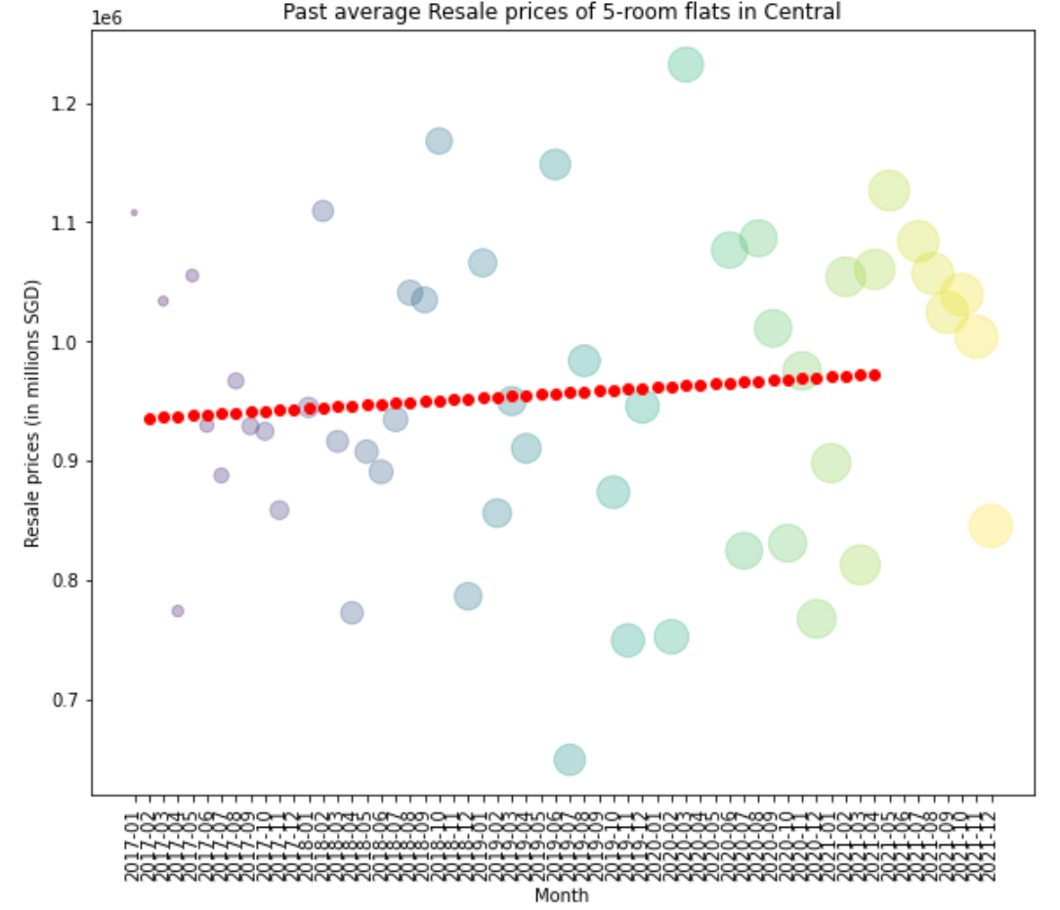
Graph 1.3 – Scatterplot of resale prices of 5 room flats in central area - Process
Data was filtered to show values of average resale prices of 5 room flats in central areas.
Np.mean was used to derive the mean prices of resale flats of 5 room flats in central
Scatterplots are then created using matplotlib function – plt.scatter, where the x-axis shows the month, and y-axis shows the mean historical resale prices.
Color style – ‘viridis’ is then applied to the scatterplot to enhance the visualization of the chart.
A trend line is also added to show the general trend in prices of 5 room flats in Central areas over the period.

Slide 10
Graph 1.3 – Scatterplot of resale prices of 5 room flats in central area - Insights
Prices in general ranged between SGD 700,000 to SGD 1,200,000. Most of the average prices were between SGD 900,000 to SGD 1,100,000. One can expect to pay this range of price to purchase a 5-room flat in central area.
Generally, there was a slight positive increase in prices of 5 room flats in central areas over the period.

Slide 11
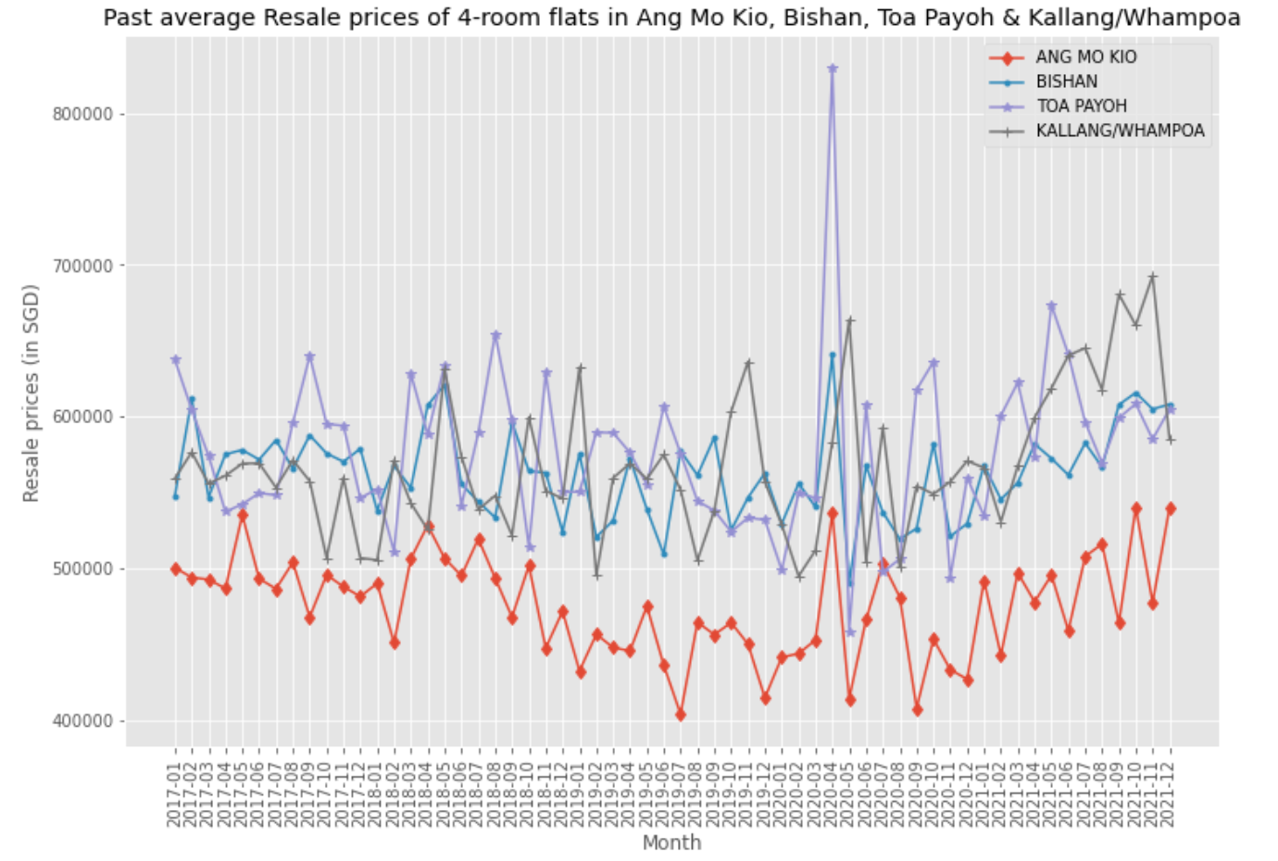
Graph 1.4 – Line plot of Average prices of 4 room flats in Ang Mo Kio/Bishan/Toa Payoh/Kallang/Whampoa - Process
Data was filtered to show values of average resale prices of 4 room flats in central areas.
Np.mean was used to derive the mean prices of resale flats of these locations
Lineplots are then created using matplotlib function – plt.plot, where the x-axis shows the month, and y-axis shows the mean historical resale prices.
Legends are included to clearly identify the trend of resale prices of each specified location.
Different markers are added for different charts for easier visualization.
‘ggplot’ style was also used in this chart to improve the visualization

Slide 12
Graph 1.4 – Line plot of Average prices of 4 room flats in Ang Mo Kio/Bishan/Toa Payoh/Kallang/Whampoa - Process
Overall, prices have been fluctuating over the period, and it is evident that house resale prices seemed to be at its peak during the early to mid 2020 period. This was probably due to the rise in demand for housing during the start of covid period.
This chart would be useful for a buyer considering a 4 room flat in a few locations, to identify how resale prices have been over the period, as well as deciding which area would be the most affordable option.
Overall, flats around Bishan, Toa Payoh and Kallang/Whampoa seems to have similar resale prices. Ang Mo Kio flats are more affordable as compared to the other 3 options.

Slide 13
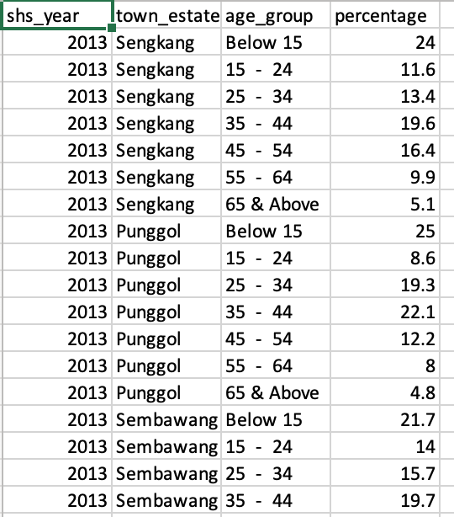
2. age-of-hdb-resident-population-by-geographical-distribution.csv
Includes details such as shs_year, town_estate, age_group, percentage
Objective: To identify the age group distribution in comparison with other age group distributions easily based on the color intensity.

Slide 14
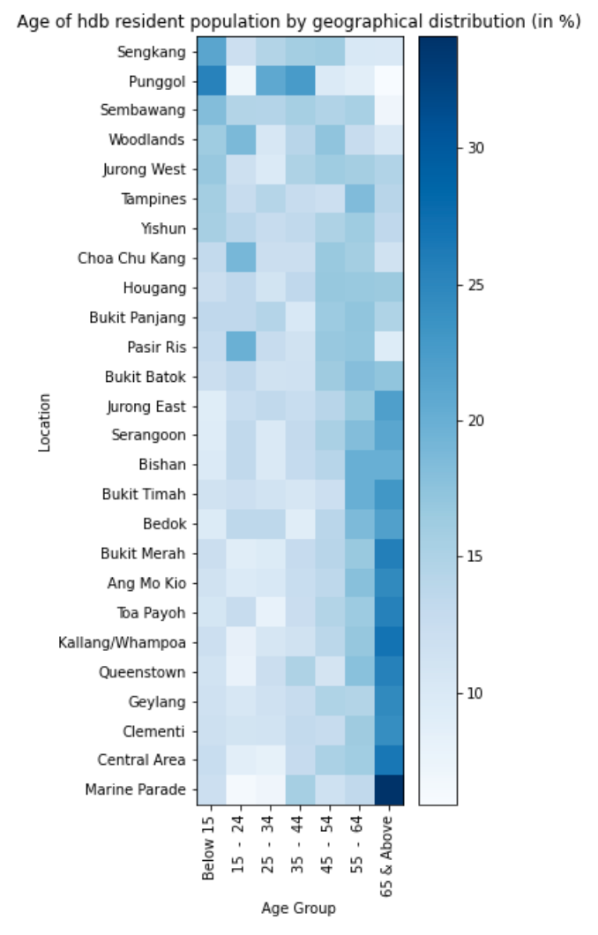
Graph 2 – Heatmap of age distribution in various towns - Process
Data has been filtered to only include 2018 values
Heatmap is created using plt.imshow, showing different colors based on the values of % of distribution. i.e. color goes from lightest to darkest shade of blue as the % increases.
A color bar has been situated at the right hand side of the chart as a general guide to the varying colors based on the % of distribution.

Slide 15
Graph 2 – Heatmap of age distribution in various towns - Insights
Heatmap is an easy and useful illustration to identify which town and has the highest % of which age group and vice versa.
For instance, Marine Parade has the highest number of residents whom are 65 and above, whilst Punggol seems to have the lowest number of residents aged between 15 to 24.
Somehow, the denser/darker colors came mostly from the age group of 65 & above, which may imply that Singapore is facing an aging population situation.

Slide 16
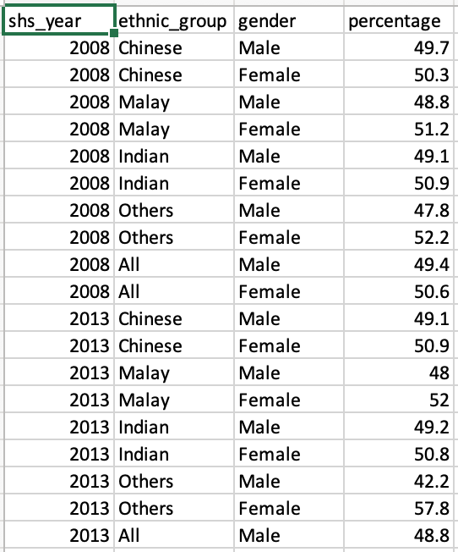
3. gender-composition-of-hdb-resident-population-by-ethnic-group
Includes details such as shs_year, ethnic_group, gender, percentage
Objective: To identify the gender composition based on different races staying in HDB flats

Slide 17
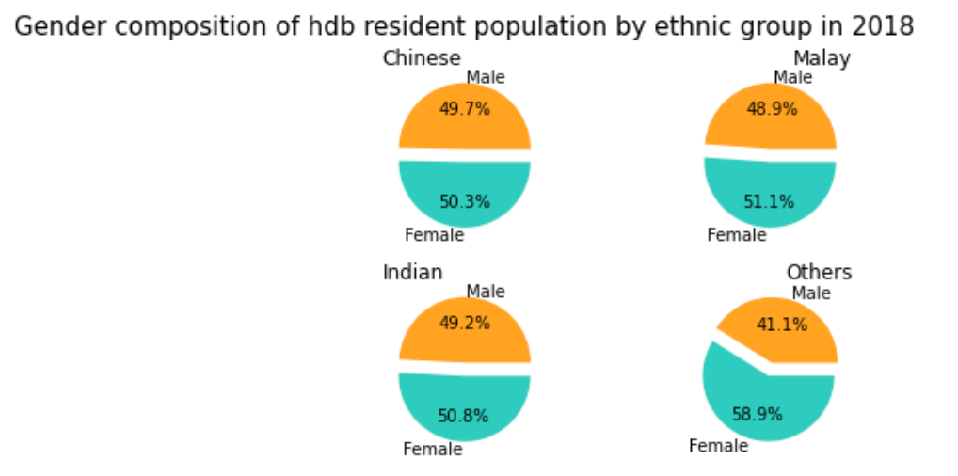
Graph 3 – Pie chart of gender composition of hdb-resident population by ethnic group - Process
Data has been filtered to only include 2018 values
Numpy arrays are then created accordingly to store values based on different races.
Piecharts are created by defining subplots, and using ax.pie, to show percentages of males and females in different races whom are staying in HDBs.
Titles of the labels and colors of the pie chart are added to enhance the visualization, making it easier to interpret the values of the dataset.

Slide 18
Graph 3 – Pie chart of gender composition of hdb-resident population by ethnic group - Insights
In general, there are more females than males staying in HDBs.
Proportion of males to females staying in HDBs is relatively constant across all races (~50+% females, 40+% males)

Slide 19
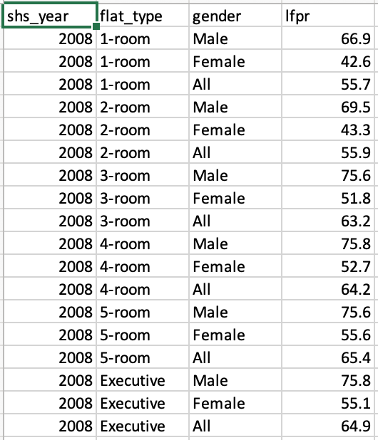
4. labour-force-participation-rate-of-hdb-resident-population-by-flat-type
Includes details such as shs_year, flat_type, gender, lfpr
Objective: To identify the labor force participation rate (lfpr) based on different flat types.

Slide 20
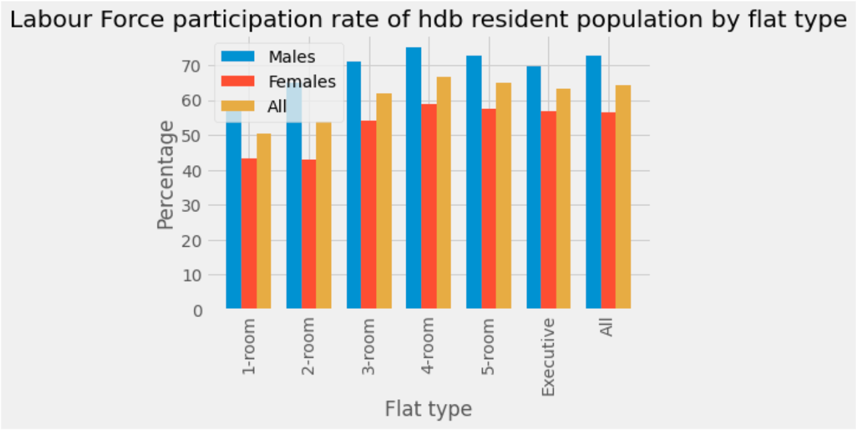
Graph 4 – Bar Chart of labour force participation rate of hdb resident population by flat type - Process
Data has been filtered to only include 2018 values, and 3 numpy arrays have been created separately for ‘Males’, ‘Females’ and ‘All’ values.
Bar chart is created using plt.bar, with the different categories stacked together horizontally using plt.subplots.
Legends, titles and axis labels are also added for clarity.

Slide 21
Graph 4 – Bar Chart of labour force participation rate of hdb resident population by flat type - Insights
In general, 1-room flat residents have the lowest labour force participation rates, whilst 4-room flat residents have the highest labour force participation rates.
There are more males than females in the labour force
The labour force participation rate seemed relatively similar for residents staying in 3-room, 4-room, 5-room and executive flats.

Slide 22
THE END

